Slide 1
Contribute to Linux Kernel
Juntong Deng

Slide 2
Is Linux kernel development hard?
Maybe...
Linux kernel is a large and complex project
Low-level programming is hard
Need to understand Linux kernel development process
...
But it is not as hard as you imagine
You just need a start

Slide 3
About me
I am Juntong Deng
Email: juntong.deng@outlook.com
Linux kernel Bug Fixing 2023 graduated mentee
Passionate about Linux kernel

Slide 4
Linux Kernel Mentorship Program
Working remotely
A Beginner’s Guide to Linux Kernel Development (LFD103)
Interesting skill evaluation tasks (you can learn a lot from them)
An opportunity to be mentored by Linux kernel maintainer
Weekly training and Q/A on Zoom
Practical graduation requirements (5-10 patches accepted into the upstream kernel)

Slide 5
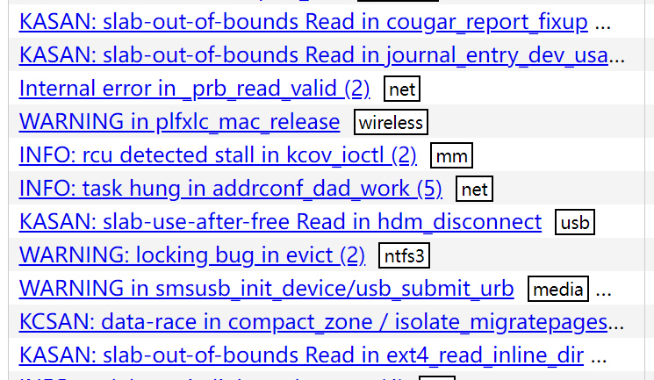
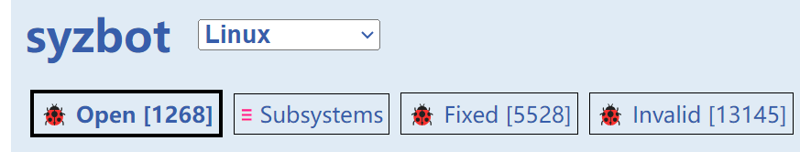
Good first issue
Linux Kernel Selftests (Kselftests)
syzbot (syzkaller.appspot.com)

Slide 6
My contributions: bug fixes
1 dynamic memory safety bug
2 runtime undefined behaviour bugs
4 bugs in kernel selftests (Kselftests)
1 bug in documentation

Slide 7
My contributions: improvements
Added the feature to KASAN (Kernel Address Sanitizer) to record and report CPU numbers and timestamps, which can help find the cause of memory bugs.
Improved storage of free meta in Generic KASAN to reduce memory consumption.

Slide 8

Let's start
You Can Do More Than You Expect!

Slide 9


Thanks
Thanks to mentor Shuah Khan and the Linux Foundation
Thank you for listening

